Slide 1
CSE110
Programming Language I

Slide 2
My Brief Profile
Nahian Salsabil (NNS)
Lecturer, CSE, BRACU
BSc: CSE, BUET, 2023
Email: Email: nahian.salsabil@bracu.ac.bd
Room No. UB80601
Consultation Hour:
Sunday: 11:00am - 1:30pm
Monday: 9:30am - 10:50am, 12:30pm - 1:30pm
Wednesday: 9:30am - 10:50am

Slide 3
Links
Resources: http://tiny.cc/cse110_resources_NNS
Slack: http://tiny.cc/cse110_slack

Slide 4
Outline
Dictionary

Slide 5
Dictionary
collection that consists of key-value pairs
index their items using keys and are unordered.

Slide 6
Necessity of Dictionary
In phonebook, if you want to collect a number, you search by name and get the number.
If you are asked to mention the page number of chapter 8 in a book. You can turn over the pages one by one and eventually find the heading Chapter 8 and then tell the page number.
However, it is faster to go to the index, look for chapter 8, and tell the page number.
In the above examples, the ‘name’ in the phonebook and the ‘chapter 8’ work as keys. So, the dictionary is needed for this kind of direct searching.

Slide 7
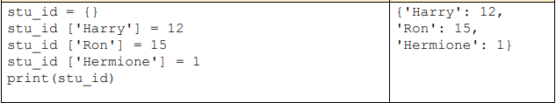

Creating a Dictionary

Slide 8
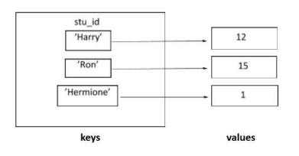
Creating a Dictionary (contd)
Visualization

Slide 9
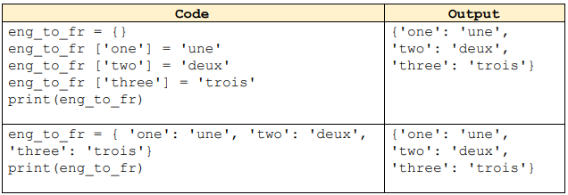
Creating a Dictionary (contd)

Slide 10


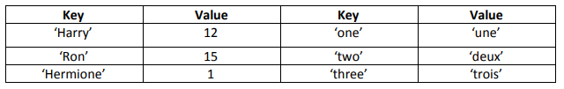
Creating a Dictionary (contd)

Slide 11

Creating a Dictionary (contd)
Keys are Case Sensitive
Empty Dictionary

Slide 12
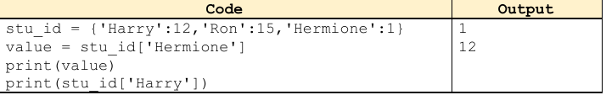
Retrieving Dictionaries
Order does not matter
Key is needed

Slide 13
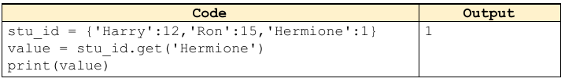
Retrieving Dictionaries
get function

Slide 14
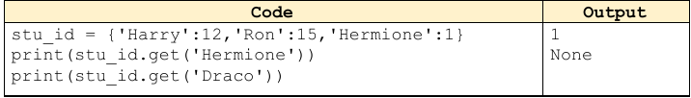

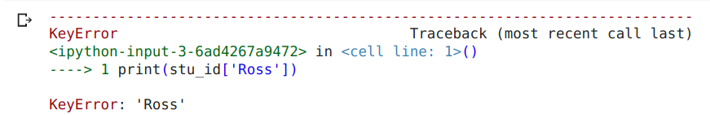
Retrieving Dictionaries
get function returns None if the key not existed
Using only Key gives an error

Slide 15
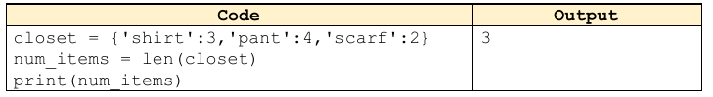
Length of Dictionaries
How many key value pair

Slide 16
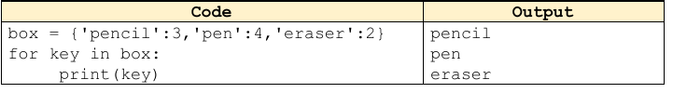
Looping through the dictionary
Print keys

Slide 17

Looping through the dictionary
Print values

Slide 18
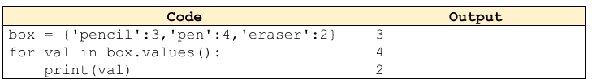
Looping through the dictionary
values()

Slide 19
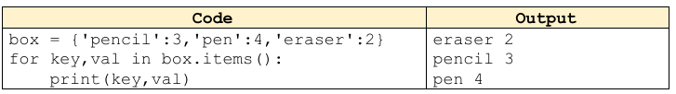
Looping through the dictionary
items()

Slide 20
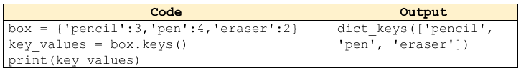
Looping through the dictionary
keys()
Returns a list

Slide 21
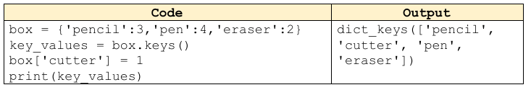
Updating the dictionary

Slide 22
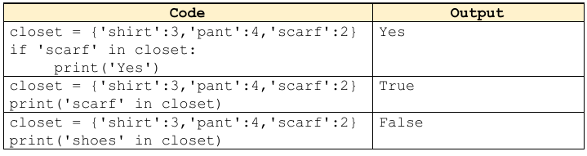
Determining if a key exists

Slide 23
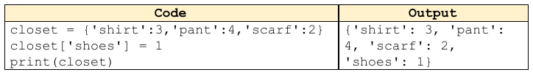
Adding element to Dictionary
Using key and assigning value to it

Slide 24
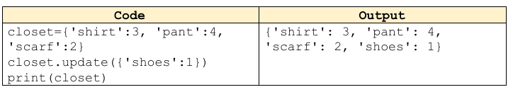
Adding element to Dictionary
Using update()

Slide 25
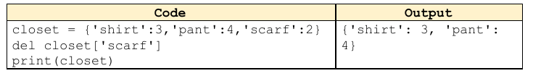
Deleting Element
Delete key

Slide 26
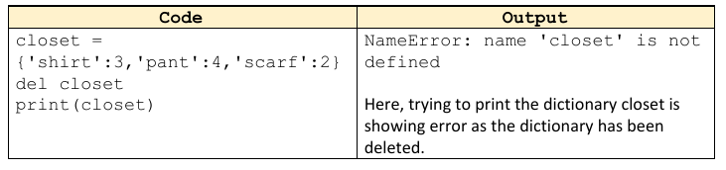
Deleting Element
Delete the dictionary

Slide 27
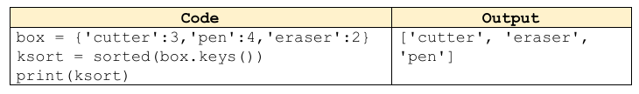
Sorting Dictionary
sorted() method
Sort keys

Slide 28
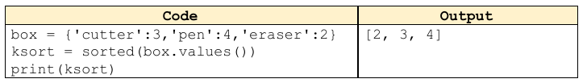
Sorting Dictionary
sorted() method
Sort values

Slide 29
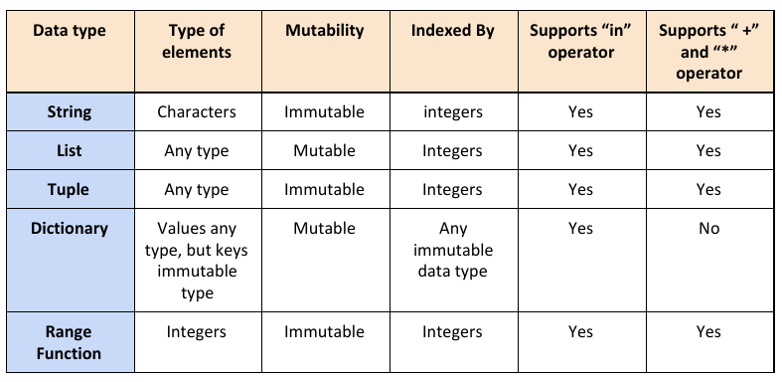
Comparison between data types

